Slide 1

Project Title – Airbnb Hotel Booking Analysis
Student Name – Mohd Nadeem Ali Ansari

Slide 2

PROBLEM STATEMENT
With the rapid expansion of the sharing economy, platforms like Airbnb have transformed how travelers find accommodation. However, due to the vast amount of data available and dynamic market conditions, it becomes challenging for stakeholders to understand:
What drives listing prices and popularity,
How location and room type affect performance, and
Which factors influence guest satisfaction the most.
This project addresses these challenges by performing an in-depth data analysis on the New York City Airbnb dataset to uncover hidden patterns, trends, and actionable insights.

Slide 3
Project Description
This project leverages data analytics and visualization to explore the Airbnb marketplace from multiple perspectives. The workflow includes:
Data Collection & Cleaning:
Import and inspect Airbnb Open Data.
Handle missing values, duplicates, and incorrect data types.
Exploratory Data Analysis (EDA):
Study property types, pricing distributions, host listings, and availability trends.
Use graphs and heatmaps to visualize market behavior.
Insight Generation:
Identify top hosts, most expensive neighborhoods, and review-based patterns.
Examine correlations between price, location, and reviews.
Visualization & Interpretation:
Generate visual summaries (bar charts, scatterplots, histograms, heatmaps).
Present findings in a way accessible to both technical and non-technical audiences.
Goal: Empower users with a clear understanding of Airbnb’s NYC ecosystem and support smarter pricing, investment, and booking decisions.

Slide 4

WHO ARE THE END USERS?
Hosts | Identify competitive pricing and improve property visibility.
Guests | Find high-rated, affordable, and well-located listings.
Investors | Discover profitable regions and property types for investment.
Tourism Analysts | Understand market distribution and traveler behavior patterns.

Slide 5

Technology Used
Languages & Tools:
Python
Jupyter Notebook
Libraries & Frameworks:
pandas, NumPy → Data Cleaning & Transformation
matplotlib, seaborn → Visualization
SciPy → Statistical Analysis
warnings, datetime → Utility Enhancements
Dataset: Airbnb Open Data (New York City)

Slide 6
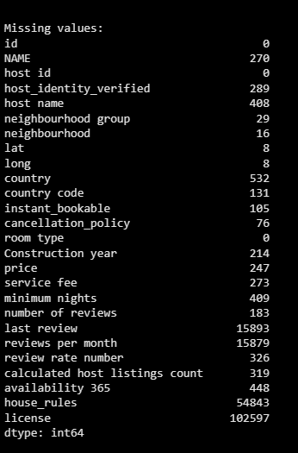
RESULTS -1
Demo Link

Slide 7
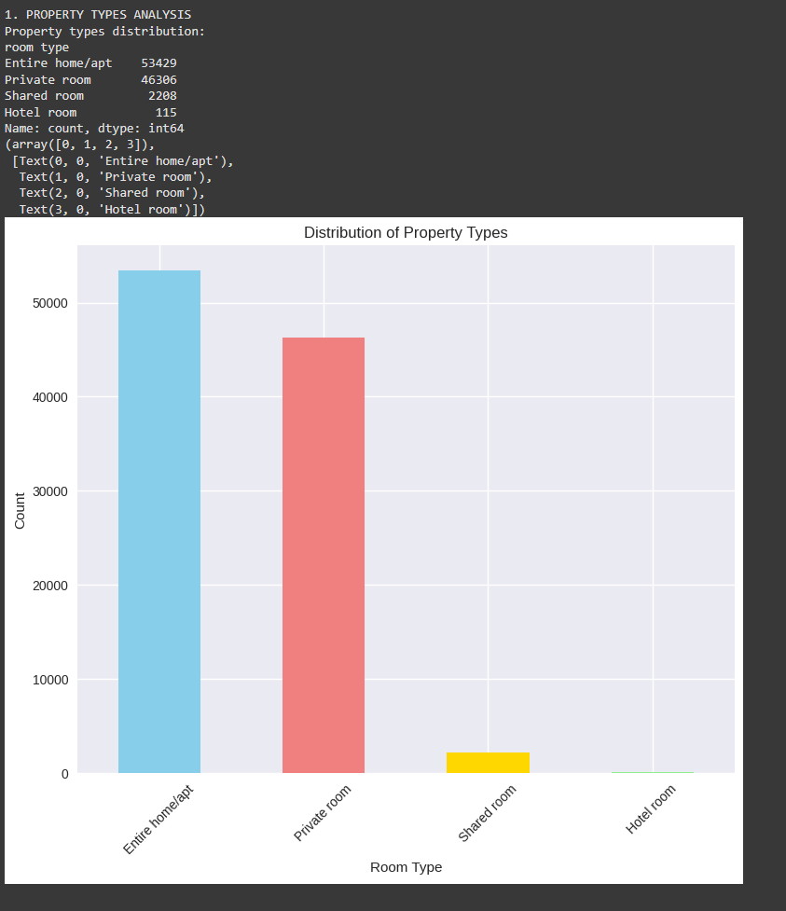
RESULTS - 2

Slide 8
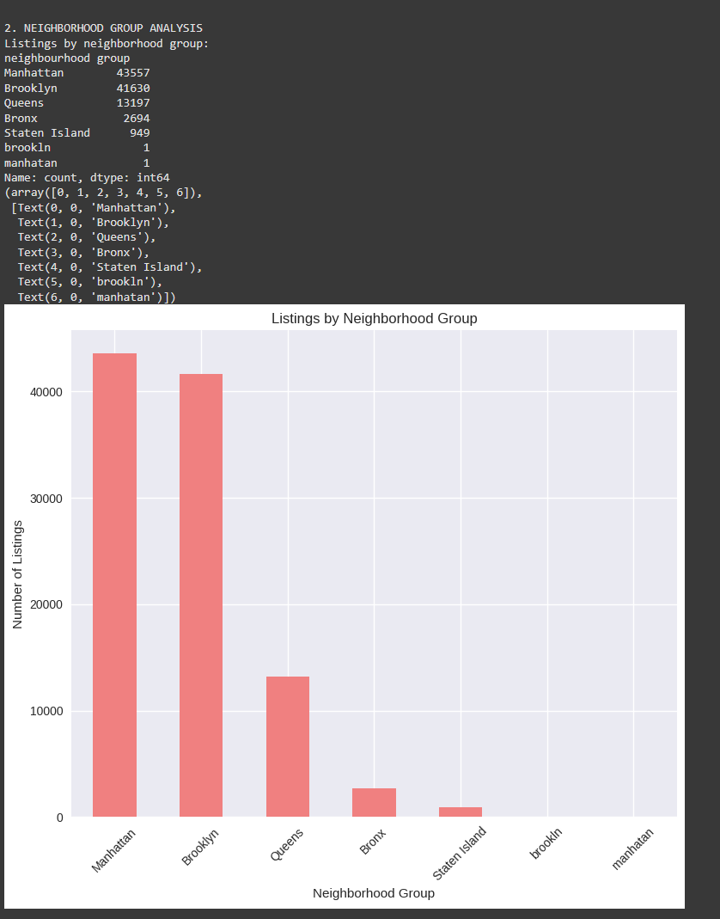
RESULTS - 3

Slide 9
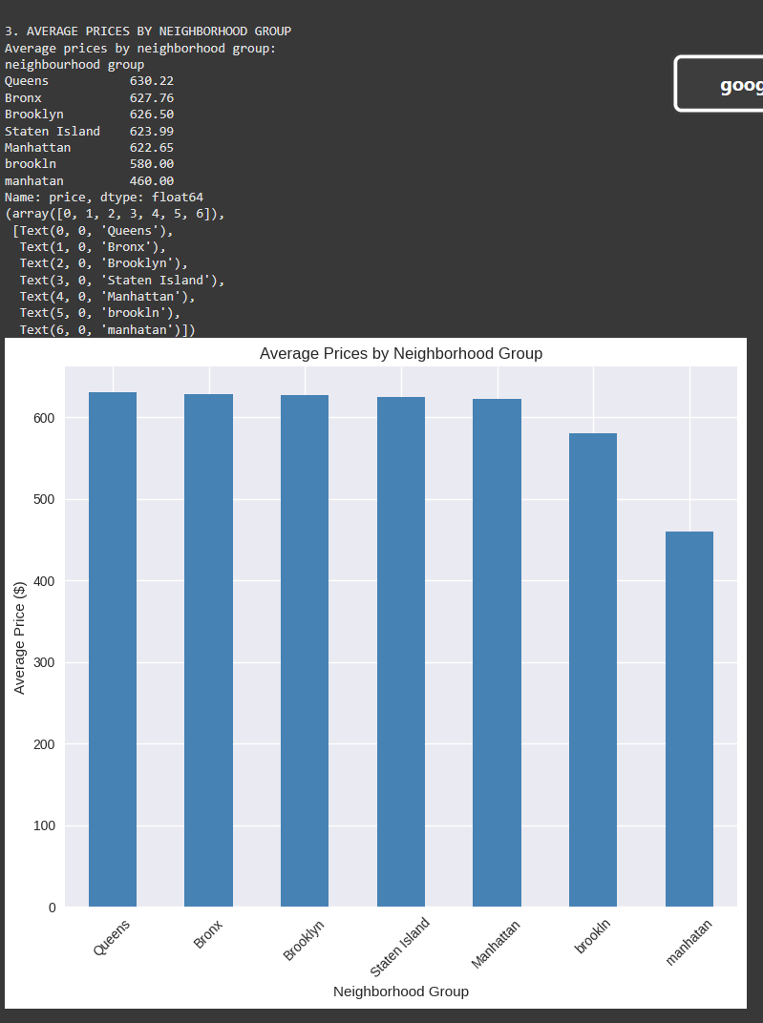
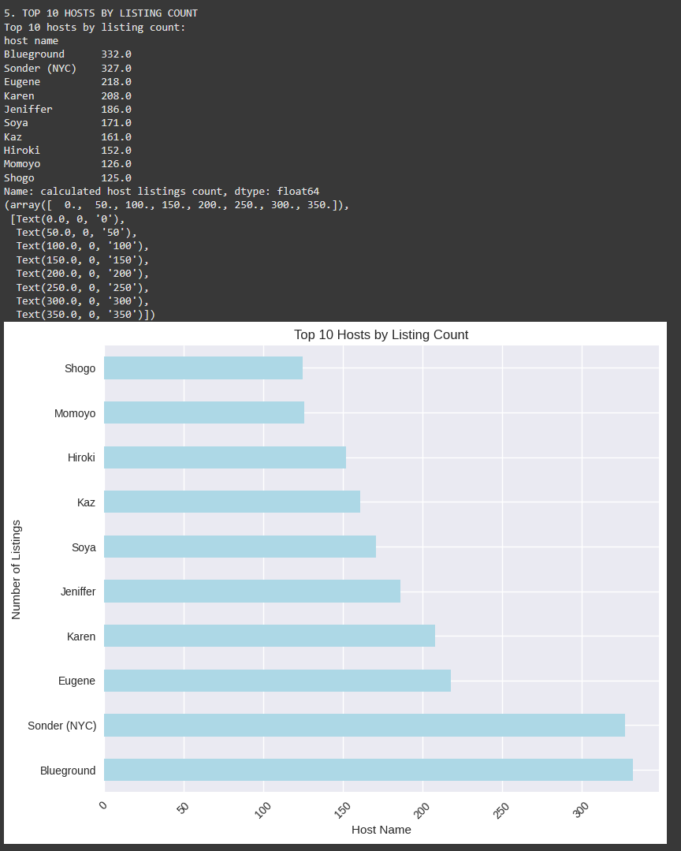
RESULTS - 4

Slide 10
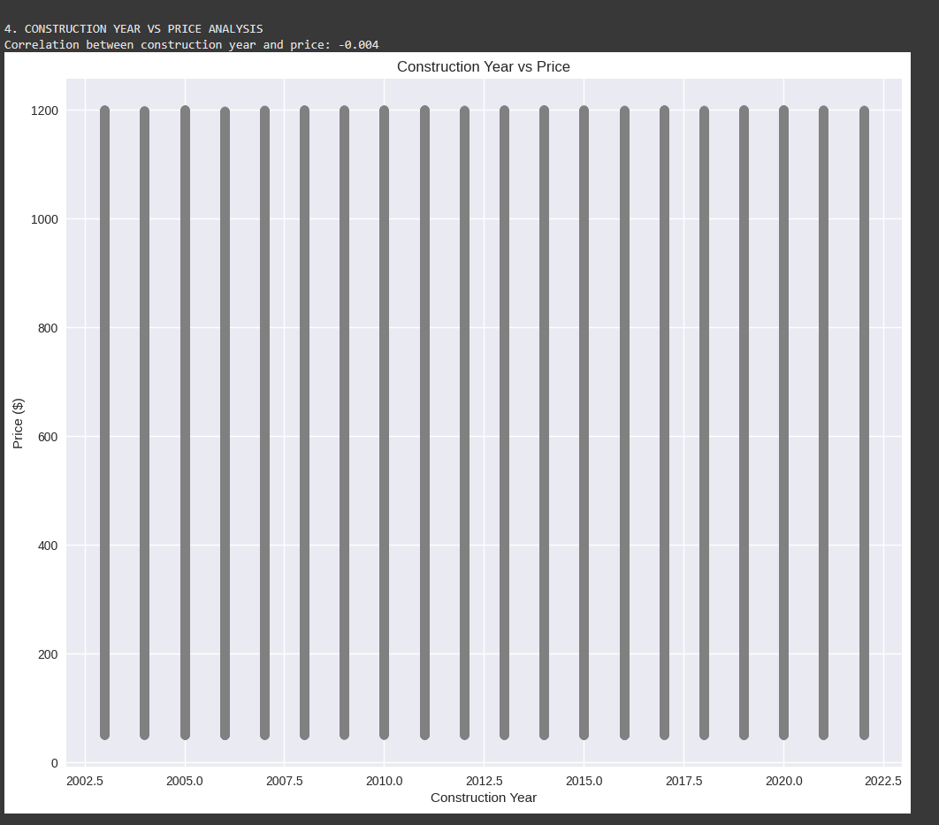
RESULTS - 5

Slide 11
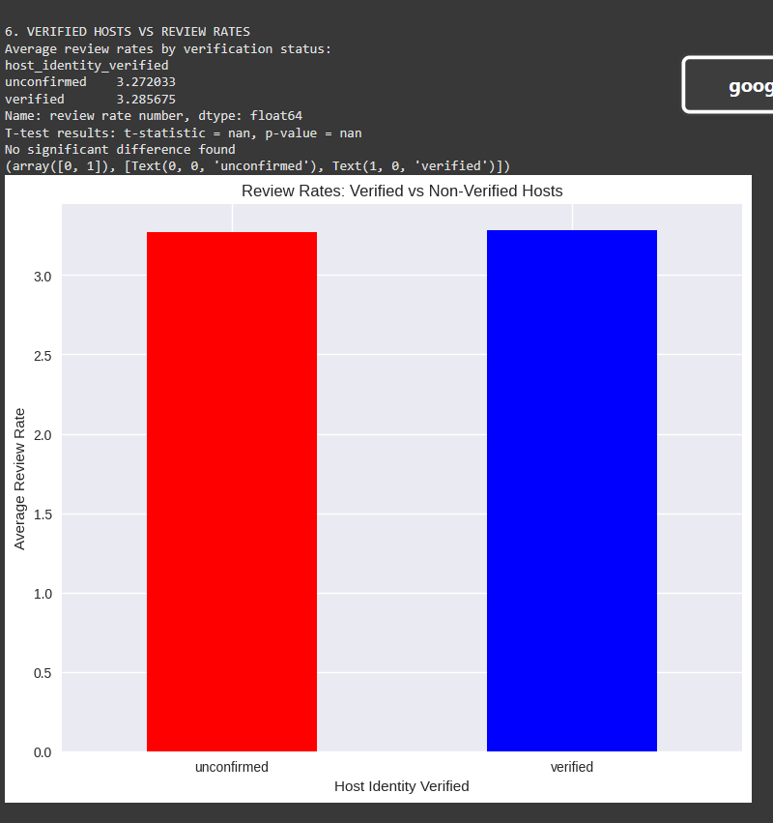
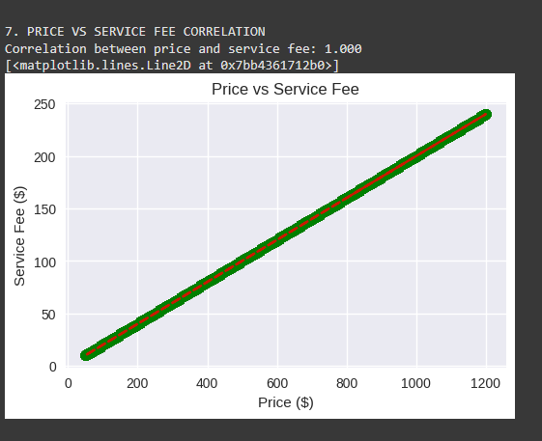
RESULTS - 6

Slide 12
RESULTS - 7

Slide 13
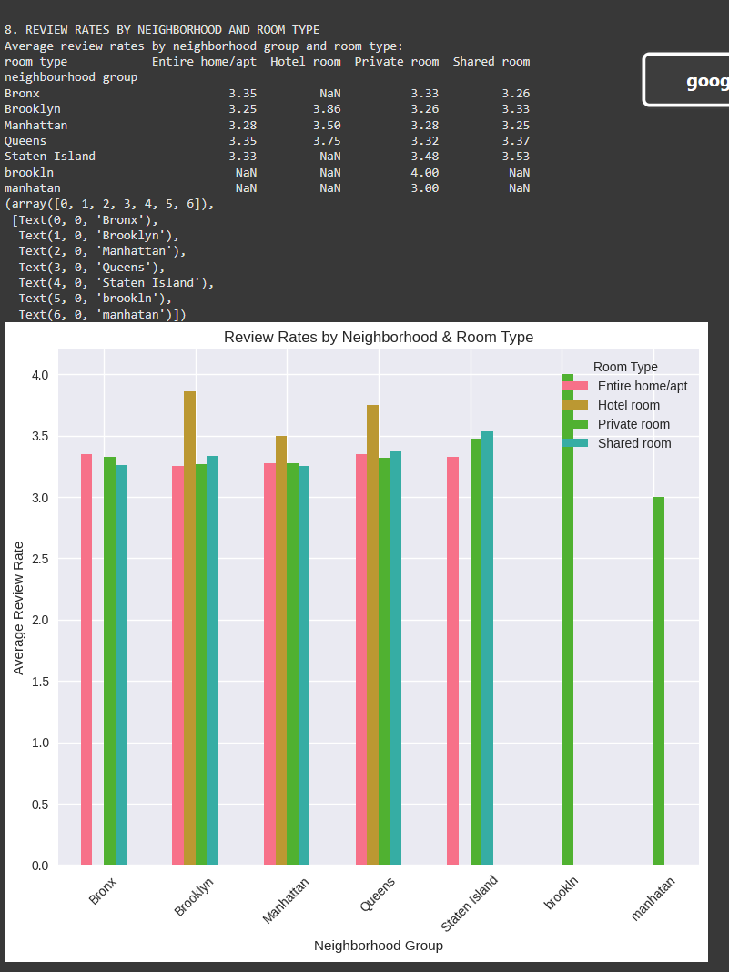
RESULTS - 8

Slide 14
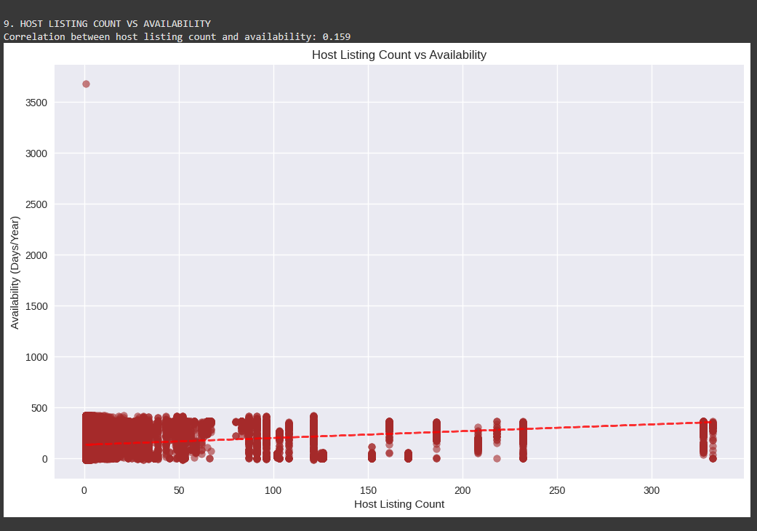
RESULTS - 9

Slide 15

Getting started with Basics of Python

Slide 16
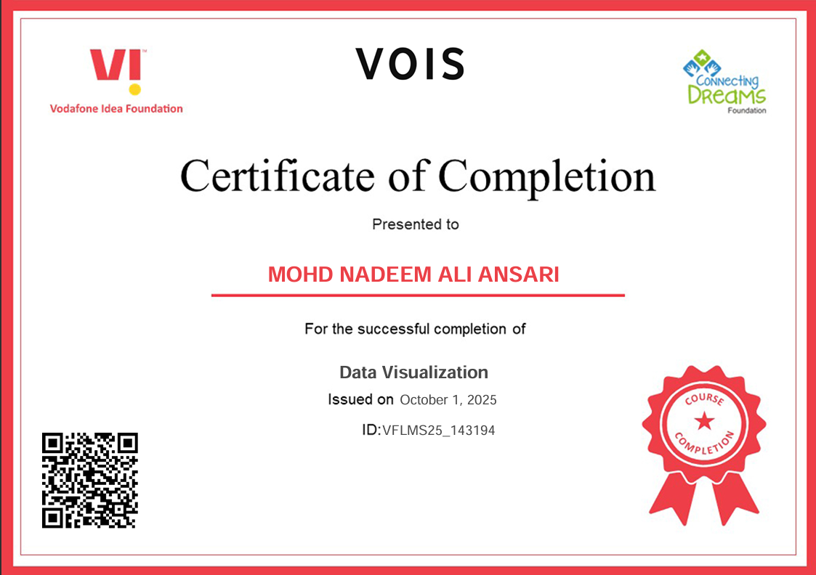
Data Visualization

Slide 17
Airbnb Hotel Booking Analysis
Mohd Nadeem Ali Ansari
Internship ID:INTERNSHIP_17546440516895be537820f

Slide 18
Repository Link
https://github.com/mohdnadeemaliansari/Airbnb-Hotel-Booking-Analysis.git

Slide 19
Thank you
.
.

